Slide 1
Bootcamp project
Student Activation Analysis

Slide 2
What is Activation?

Slide 3
Exploratory Data Analysis

Slide 4
Feature Engineering
There was no need for it to be done in python as I have done it in SQL when I was pulling the data from our database.

Slide 5
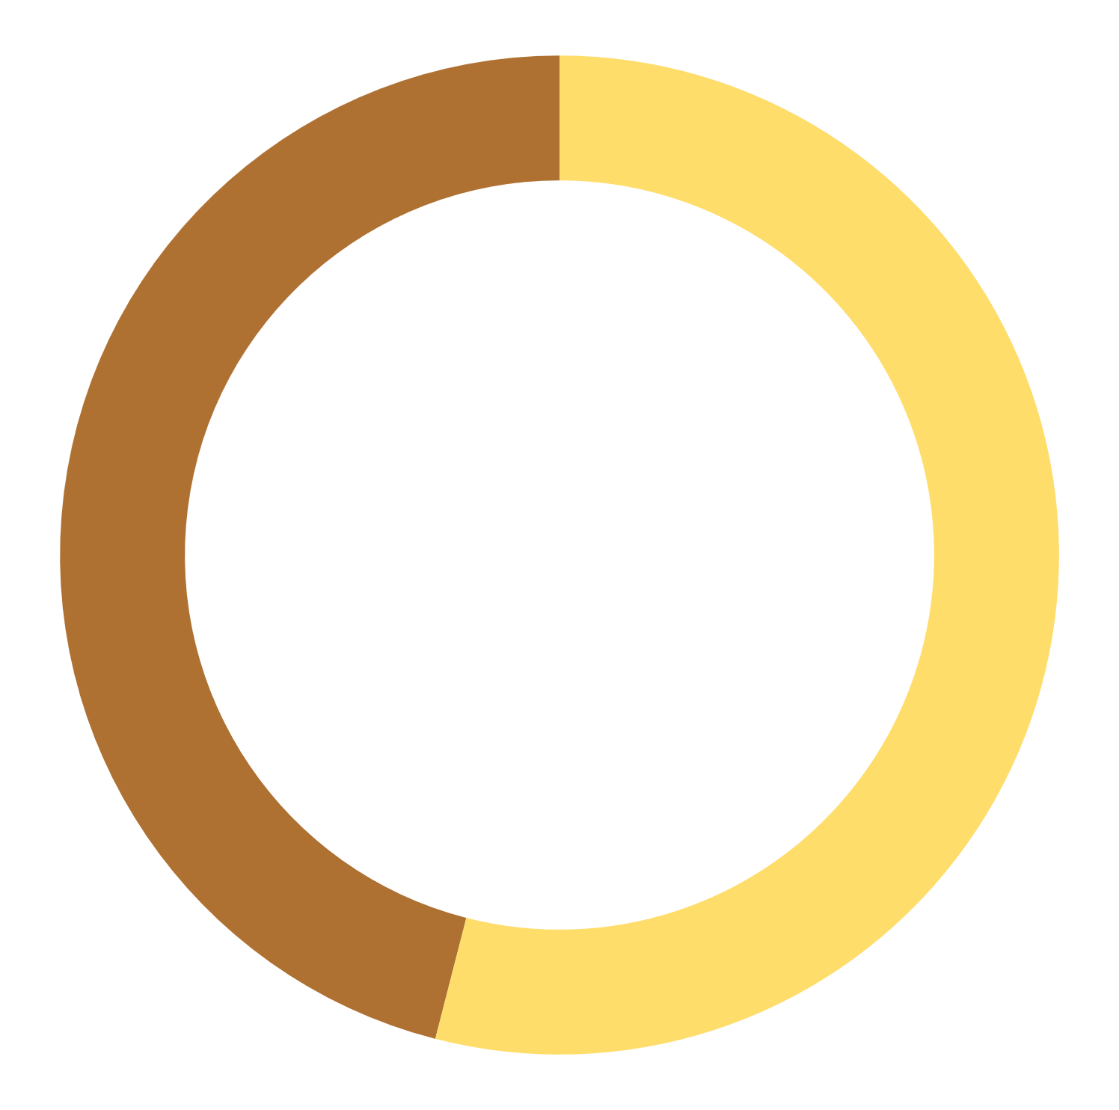
How many students are activated in this dataset
Split activated student – non activated students
There are approximately 4.6k activated students while the rest are not almost 5.4k students.
Activated
Non activated
46.2%
53.8%

Slide 6
What was students’ behavior?
Although most of these students are not activated, we see that the activated students explore the platform more.

Slide 7
Prediction Models

Slide 8
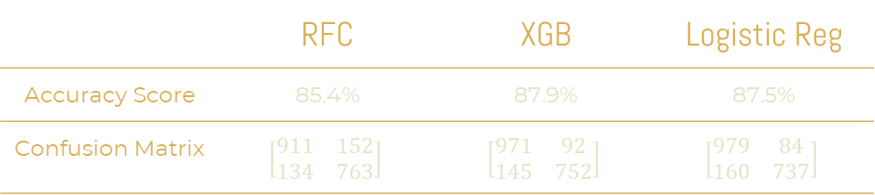
RFC vs XGB vs Logistic Regression
 | RFC | XGB | Logistic Reg
Accuracy Score | 85.4% | 87.9% | 87.5%
Confusion Matrix | $$\left[\begin{matrix}911 & 152 \\ 134 & 763\end{matrix}\right]$$ | $$\left[\begin{matrix}971 & 92 \\ 145 & 752\end{matrix}\right]$$ | $$\left[\begin{matrix}979 & 84 \\ 160 & 737\end{matrix}\right]$$

Slide 9
What Feature Has The Most Impact On The Model?
From the graph shown we can say the more student attend multiple live sessions the more activated students we get.
Feature Importance

Slide 10
THANKS!
DO YOU HAVE ANY QUESTION?
addyouremail@freepik.com
+91 620 421 838
yourcompany.com
THANKS!
Any questions?
Please keep this slide for attribution.

